Slide 1

The technology value stream
Garrett Woods
Module 1.2

Slide 2
What is the technology value stream?
The steps needed to change a business idea into a technology-enabled service of feature that delivers value to the customer.

Slide 3
Lead time vs process time
Lead time starts when the request is put in while process time starts when you start working on the ticket. If you were building a deck, the lead time would start as soon as you sign the paperwork, but the process time would start when they show up to build the deck.

Slide 4
My lead time is into the months, why is that?
If your lead times are on the longer side you may need to look at the smaller picture. Are you working with system that are old and have grown into a massive, hardly-manageable system? Do you have testing done manually when you could automate that? Are there some areas that you can streamline the approval process?

Slide 5
IT’s my lead time and I want it now! What steps can you take to shorten your lead time?
To keep your lead times down, you want to make sure you sending feedback to you developers as often as possible. This allows them to adapt their code quickly, and more importantly independently, so that you can deploy the fix in a timely manner.
By keeping your architecture modular, well encapsulated, and loosely coupled you’re able to have small teams working on several parts of the project at once, and with a high degree of autonomy since you’re able to bring each part together when they’re done. If one part does fail, you can easily have that team work on the failure and have all the other teams continue working with no interruption.

Slide 6
In the Technology Value Stream, lead time starts as soon as the change request comes in.
WHEN DOES LEAD TIME START?

Slide 7
How long should my lead time be?
Ideally, you want you lead time as short as possible. You want to make sure you’re not cutting any corners though, which means it is imperative to have an efficient Value Stream and that everyone is working how they need to be.

Slide 8
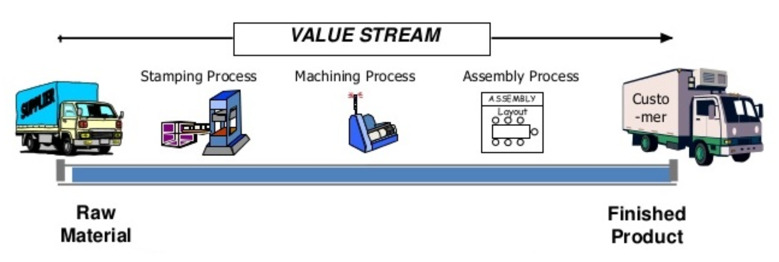
The following graphic is a great representation of the Value Stream, even though it is for a physical product and not software. You can see how your team receives the Raw Materials (the ticket) and then moves onto what needs to happen to make their product in an organized and efficient manner.
Paauwe, M. (2025). Value Stream Definition | Dragon1 Open EA Method. Dragon1.Com. https://www.dragon1.com/terms/value-stream-definition

Slide 9
Kim, G., Humble, J., Debois, P., & Willis, J. (2016). The DevOps Handbook. IT Revolution.
Paauwe, M. (2025). Value Stream Definition | Dragon1 Open EA Method. Dragon1.Com. https://www.dragon1.com/terms/value-stream-definition
References

